Slide 1
Knowledge come and spread from here
Project Presentation
BiubiuTube
Presented by Cottage
2017.12.13

Slide 2


CONTENTS
CONTENTS
01
Problem Statement
02
Solution
03
04
Object Model and scope
Important use cases

Slide 3

01
Problem Statement

Slide 4



Problem Statement
Providing Optimal Solution for Student, Professors, Advertisement Company, University and NGO
Students
Lack of Educational Resources
Professors
Lack of Reliable Platform
Advertisement Company
Need some way access to students
Non-profit Organization
Access to students and foster love
Extracurricular Organization
Want to share their knowledge with students
University
Desiring a easy-managing platform

Slide 5
02
Solutions

Slide 6
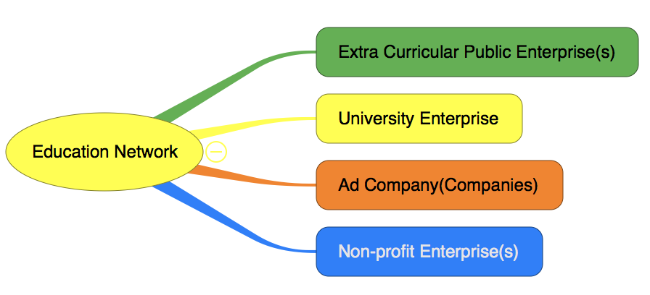
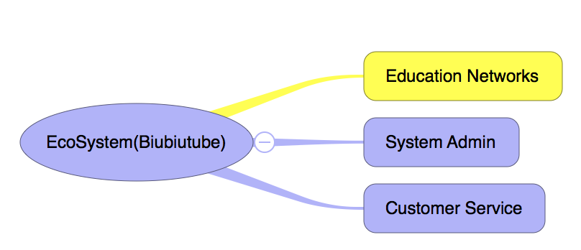
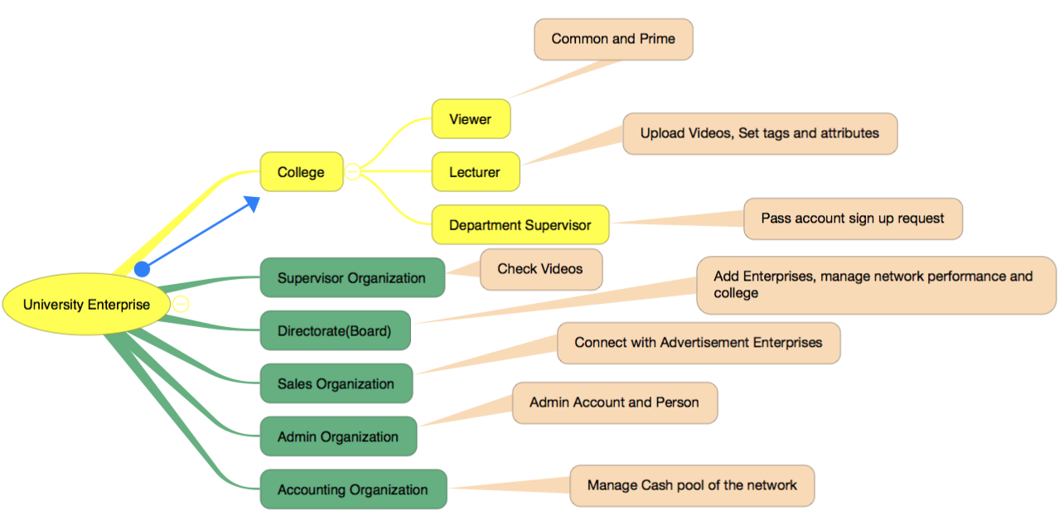
Solution 1
Easy-managing platform

Slide 7

Solution 2
Strict reviewing work-queue
Review by College/Department Supervisor
Upload by Lecturer/Producer
Review by Network Supervisor
Issue

Slide 8

Solution 3
Other Unique Features
User Validation and Active
Comment, Vote and Report a video
(Search Videos Based on votes, professor, subject or tags)
Coins and primiership System
(Advertisement display order for advertisement companies)
Network performance management
(Distribute some money to NGO)

Slide 9
03
Overall Object Model

Slide 10
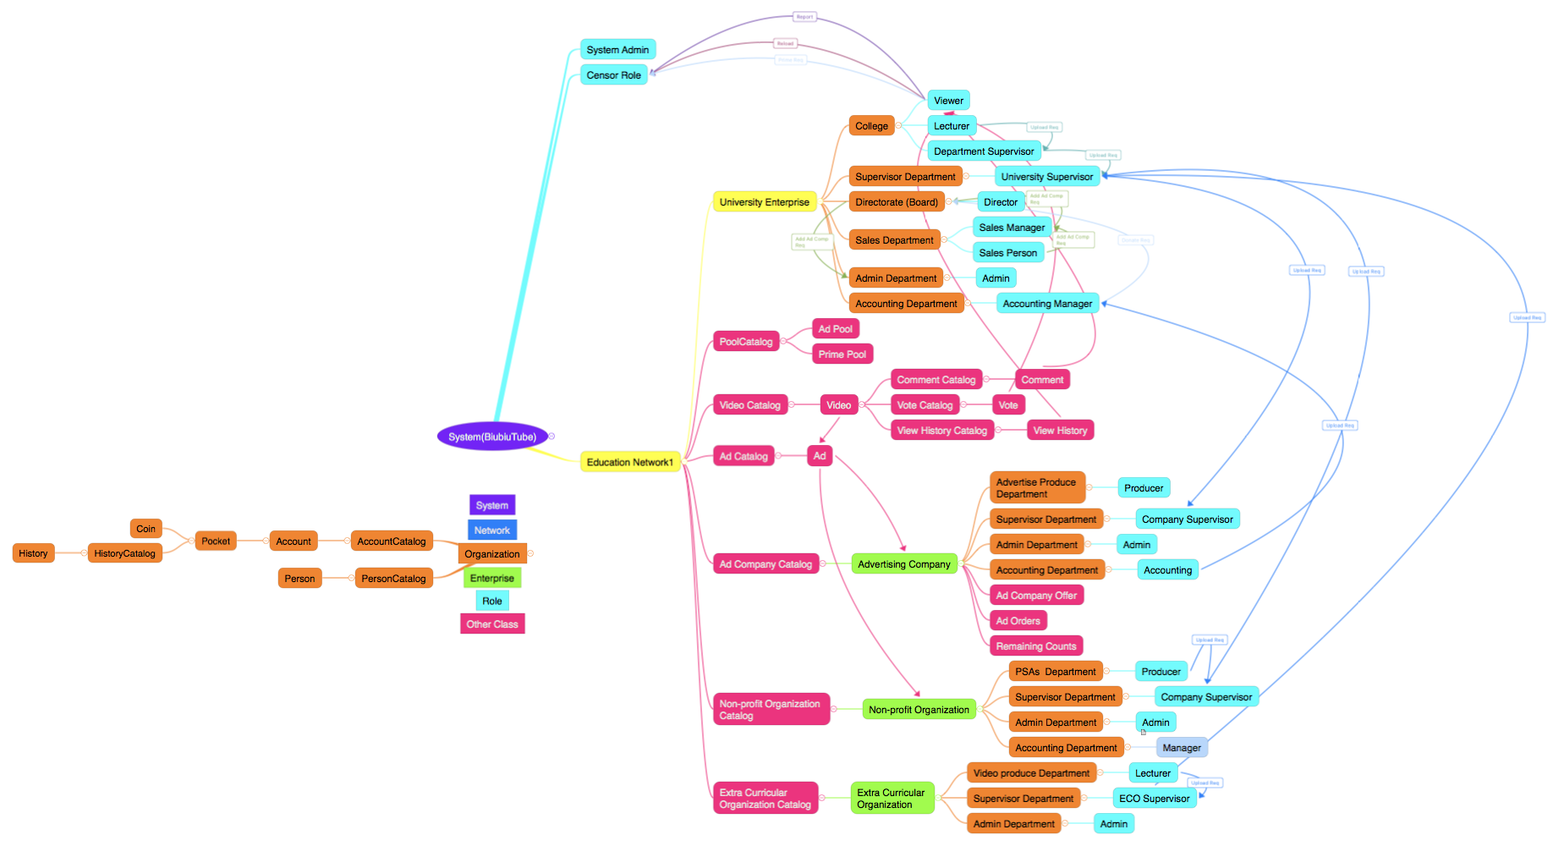
Overall Object Model

Slide 11
04
Important use cases

Slide 12
THANKS FOR LISTENING

